Slide 1

From Stories to Strategies:
Uncovering Entrepreneurial Success Factors Through Podcast Transcript Analysis
Akinyi Wendy

Slide 2

Problem Definition
Entrepreneurial success is often attributed to a combination of effectual and causal logic, human capital, and industry-specific strategies.
However, existing studies lack depth in understanding the nuances of these factors, particularly across diverse demographics and industries.
This project aims to address this gap by analyzing podcast transcripts of successful entrepreneurs to identify patterns and success factors in their journeys.
To help startups refine strategies based on key entrepreneurial behaviors.

Slide 3

Dataset
"How I Built This" Podcast Transcripts
Source: NPR API and web scraping
Features: Founder stories, business strategies, challenges, solutions
Collection Method: Custom Python scraper using Selenium.
Number of episodes = 738
Columns: Episode ID, Episode Name, Transcript Text
Data Cleaning: Tokenization, NaN(5), Ads and timestamp removal, Lemmatization, lowercase, stop word removal using nlp spacy and re(regular expression)

Slide 4
Objectives
1.
2.
3.
What common patterns emerge in successful entrepreneurial journeys?
What are the key success factors mentioned across different industries?
Can we identify and classify different entrepreneurial strategies?

Slide 5
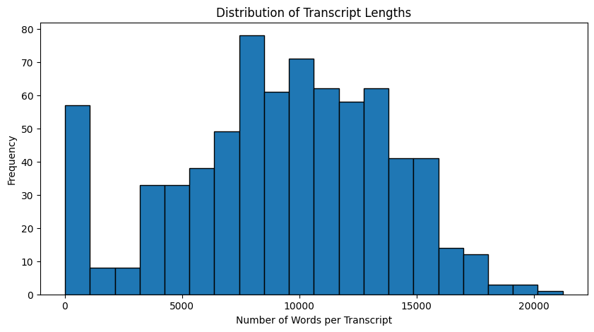
Transcript Lengths
A majority of transcripts fall within the 5,000 to 15,000 range.
There is a significant number of shorter transcripts (< 2,000), suggesting the presence of brief content.
The most common transcript length appears to be around 8,000–10,000 words, as indicated by the highest frequency bars.
There are a few exceptionally long transcripts (> 16,000 words), but they occur less frequently.

Slide 6
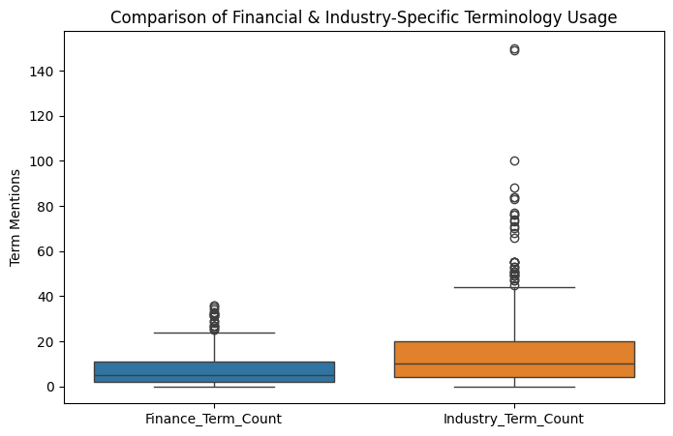
Finance & Industry Terms
Finance terms are less frequently mentioned compared to industry-specific terms.
#Finance_terms ("funding", "investment", "capital", "equity", "profit", "loss“)
#industry_terms ("technology", "fashion", "food", "software", "retail", "health")e.t.c
Most discussions are industry-focused rather than finance-heavy

Slide 7
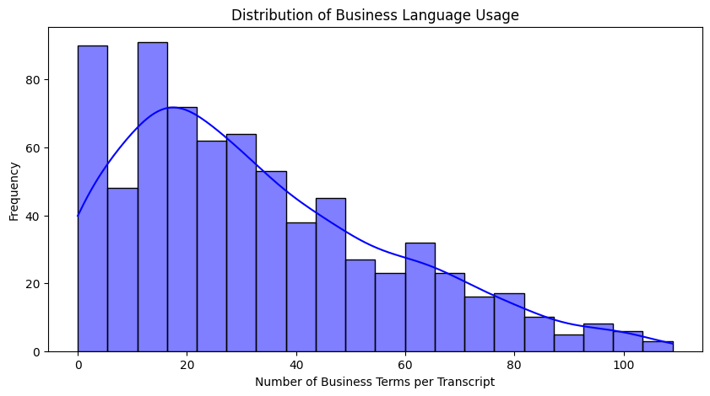
Business Language Usage
The histogram is right-skewed, meaning most transcripts have lower business term usage, but some contain a high density of these terms. (profit, revenue, investment, market, growth, customers, sales , product e.t.c)
The smooth KDE (Kernel Density Estimate) curve further confirms this trend, with a peak around 15-20 business terms per transcript.
The most common transcripts contain between 10 and 30 business terms, indicating that business language is present but not always dominant.
Transcripts with fewer business terms (closer to 0) likely focus on personal stories or general advice while those (closer to 100) have more hardcore business concepts.

Slide 8
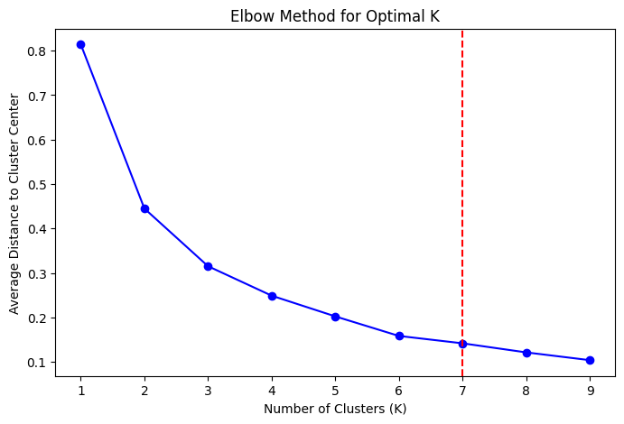
Kmeans Clustering
Here is the Elbow Method Plot with a vertical red dashed line indicating the optimal number of clusters (K = 7).
The elbow point (K = 7) is where the distortion curve starts to level off.

Slide 9
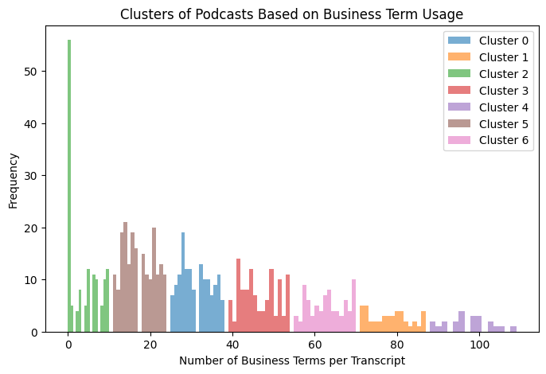
Kmeans Clusters
Cluster 2 (Low Business Term Usage) <10
5&0(Moderate Usage) 10-40
3&6(business focused) 40-70
1&4(High Usage) >70
Most episodes fall into the low-to-moderate business term range.
A smaller number of transcripts are highly technical or finance-heavy.

Slide 10
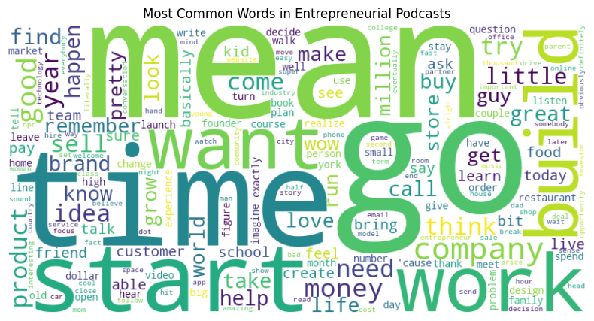

Slide 11
WordCloud
Mindset & Decision Making
Ideas & Innovation
Funding & Financials
"try," "happen," "decide," "risk," "change"
Entrepreneurship requires taking risks and embracing change.
Founders frequently discuss decision-making processes and the mindset needed to adapt.
Time and Persistence
"time," "year," "long," "moment"
The journey to success often takes years, and entrepreneurs reflect on key moments that shaped their business.
"idea," "product," "create," "develop," "market"
Entrepreneurship is heavily centered around innovation—turning an idea into a product and bringing it to market.
Success and Growth
"start," "build," "grow," "business," "company," "work"
Entrepreneurs frequently discuss starting a venture, building a brand, and strategies to grow.
"sell," "money," "invest," "need," "cost"
A crucial aspect of entrepreneurship is raising capital, selling products, and managing costs.
Networking and Relationships
"team," "friend," "partner," "family"
Entrepreneurs emphasize the importance of building strong teams, partnerships, and support networks.

Slide 12
Keyword Extraction for Key Themes
Business & Strategy Keywords:
'brand', 'build', 'business', 'buy', 'company', 'product', 'sell', 'start', 'store‘.
These suggest strong focus on building businesses, branding, and sales.
Financial & Growth Terms:
'money', 'make', 'need'
Indicate that entrepreneurs frequently discuss finances, capital, and funding strategies.
Personal & Motivational Words:
'idea', 'help', 'life', 'love', 'think', 'time', 'try', 'want', 'work', 'world'
These highlight passion-driven discussions, reflecting the emotional aspect of entrepreneurship.
"Try", "want", "think" suggest that entrepreneurs emphasize innovation, problem-solving, and ambition.
Emotional & Conversational Words:
'great', 'good', 'wow', 'thank', 'yes', 'listen', 'tell', 'talk'
Reinforces that these podcasts have a positive & conversational tone, matching the sentiment analysis results.

Slide 13
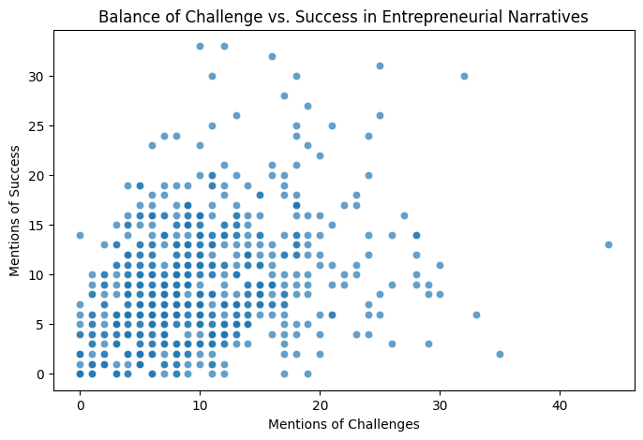
Challenge Vs Success
Most data points fall between 0-20 mentions of challenges.
Podcasts mentioning more challenges also tend to mention more successes (Positive Correlation)—suggesting a storytelling pattern where struggles lead to success.
Different types of entrepreneurial journeys emerge:
Low Challenge, High Success: Likely seasoned entrepreneurs or success-story-focused episodes.
High Challenge, Low Success: Likely failures or hard lessons in startups.
Balanced Challenge & Success: Typical founder journeys, discussing both struggles and wins.

Slide 14
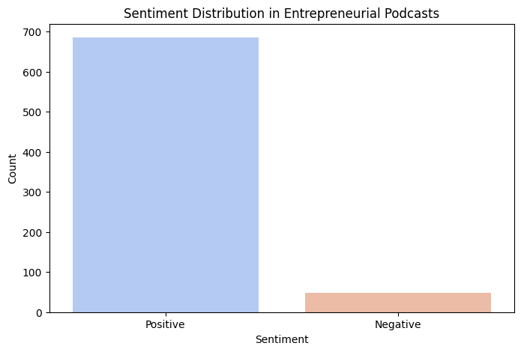
Sentiment Analysis
Entrepreneurial podcasts are overwhelmingly positive.(+685, -48).
This could mean entrepreneurs focus more on growth, success, and motivation rather than struggles.
Very few episodes focus on failures, obstacles, or negativity.
**Possible Bias in the Data** Only successful entrepreneurs get featured.

Slide 15
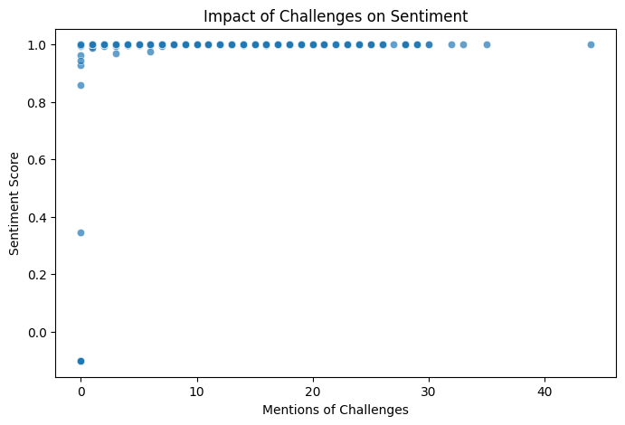
Challenges Vs Sentiment
Most data points are clustered near 1.0 (positive sentiment score), even when challenges are mentioned frequently.
Data points closer to 0.0 (neutral or negative) could be episodes that focus on failures, struggles, or setbacks without immediate resolution.
Entrepreneurs likely frame struggles as learning experiences rather than failures.
**Possible bias** If challenges were framed more negatively, we’d get a stronger downward trend in sentiment.

Slide 16
CONCLUSIONS
1. What common patterns emerge in successful entrepreneurial journeys?
Through Sentiment Analysis we found that entrepreneurs frame challenges positively, suggesting a resilience-based success pattern.
2. What are the key success factors mentioned across different industries?
The word cloud and keyword analysis highlighted themes like "build," "grow," "company," "idea," "money," "work," which consistently appear in successful stories.
Keyword frequency analysis highlighted terms like "brand," "investment," "growth," "sell," "scaling," "money," indicating that these are core success factors.
3. Can we identify and classify different entrepreneurial strategies?
Clustering analysis segmented podcasts into low, medium, and high business term usage, helping categorize different entrepreneurial strategies:
Low-business term clusters → Personal storytelling & general motivation.
Mid-level clusters → Balanced insights between personal and business strategy.
High-business term clusters → Deep business strategies, investment discussions, and financial planning.

Slide 17
FUTURE IMPROVEMENTS
Expand dataset size and sources
Incorporate more **podcast transcripts** from different sources, including YouTube and TED Talks.
Advance Topic Modeling
Implementing Latent Dirichlet Allocation (LDA) or BERT-based topic modeling.
Implement advanced ML models
Explore predictive modeling for identifying podcast success factors.
Create interactive visualization tools
Develop dashboard visualizations using Plotly or Streamlit for real-time data exploration.
Allow users to **filter and compare podcast insights** based on keywords, sentiment, and business term density.
Develop recommendation system
Build a podcast episode recommendation engine that suggests content based on user preferences.

Slide 18
THANKS!

